Slide 1

SORTING VISUALIZER
BANSAL INSTITUTE OF SCIENCE AND TECHNOLOGY BHOPAL (M.P)
DEPARTMENT OF COMPUTER SCIENCE AND ENGINEERING

Slide 2
HOD Prof. Manish Saxena (Asst. Professor, Dept. of CSE, B.I.S.T., Bhopal)
GUIDE BY: Prof. Anshu Tiwari (Asst. Professor, Dept. of CSE, B.I.S.T., Bhopal)
Presented By: GROUP MEMBERS 1. Saurabh Patil 2. Rahul Gupta 3. Rahi Turkar 4. Gagan Bisen

Slide 3
01
02
03
04
ABSTRACT
INTRODUCTION
IMPLEMENTAED METHODOLOGIES
SIMULATION RESULTS
PRESENTATION FLOW

Slide 4
05
06
CONCLUSION AND FUTURE SCOPE
REFERENCES
PRESENTATION FLOW

Slide 5
01. ABSTRACT
For the better understanding of different sorting techinque we have built this project

Slide 6
Introduction
Bubble Sort
Selection Sort
Insertion sort
Quick Sort
This is a simple visualization project made using JavaScript
It helps users to have better understanding of complicated topics, such as:
Merge Sort

Slide 7
IMPLEMENTED METHODOLOGIES
HTML
CSS
JavaScript
To built the skeleton of the Website.
To make the visualization more presentable.
For animation and for the working of the logics.

Slide 8



INTRODUCTION
NEW ARRAY
SIZE
SPEED
Generates random new array, whenever clicked
Defines the size of the array
Sets the speed of the sorting

Slide 9
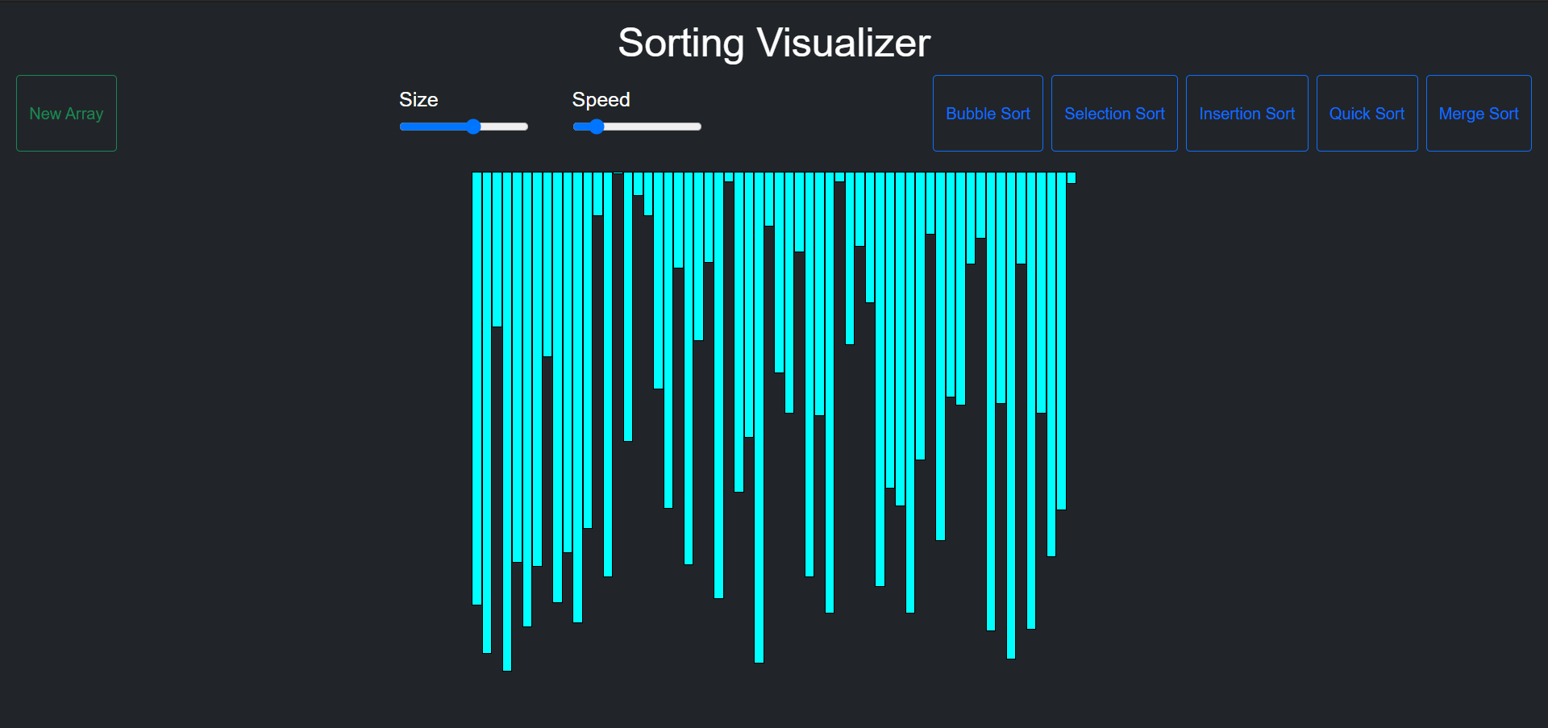
RECTANGUALR BARS
Different length of the bar denotes, different elements of the array having different values.

Slide 10

COLOR SYMBOL
Green - Sorted
Blue - Comparing
Pink - Swapping
Yellow - Pivot
Red - Current
Different colours are used for different purposes.

Slide 11
BOTTOM SECTION
NAME OF THE SORTING METHOD
PERFORMANCE OF THE METHOD
Example:
About Merge sort
And how merge sort is performed
About the complexity of the method

Slide 12

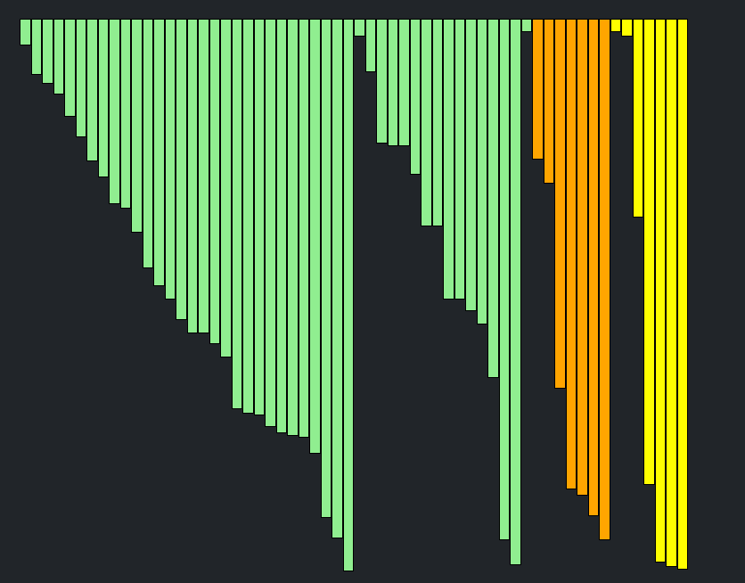
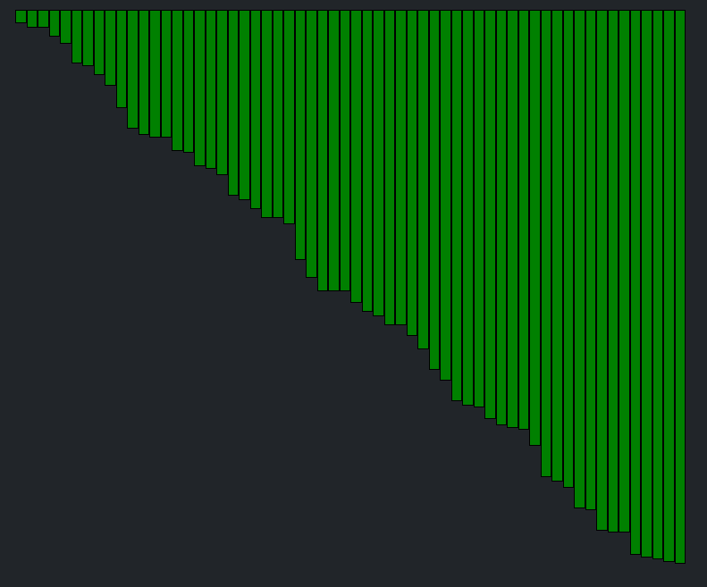
SIMULATION RESULT
NEW ARRAY
SORTING
AFTER SORTING

Slide 13
CONCLUSION
It is much better way to understand sorting techinque, which is theoretically very much complicated.
With the visualization of these complicated topic, it becomes very much easy to understand.

Slide 14
FUTURE & SCOPE
We can include various new topic, which are also difficult to understand theoretically, such as
Tree
Graph
Hashing
Etc..

Slide 15
THANK YOU!

